Slide 1


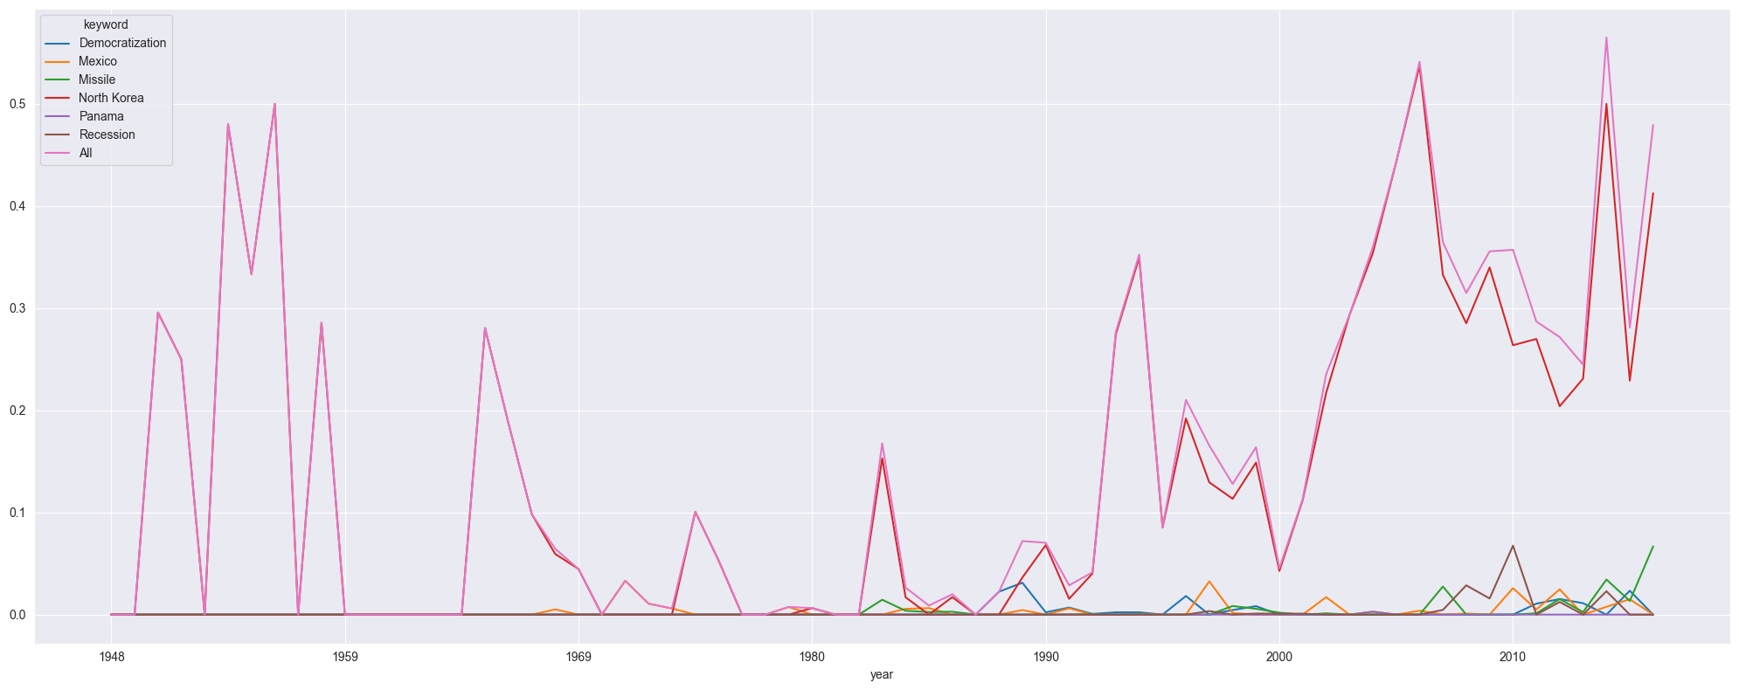


Address Embedding
Interaction
Topical
Interaction Analysis
Presidential
Address
Similarity > 0.7
Time
T1
T2
T3
Lexicon-based Sentiment Analysis
Stance Analysis
Positive
Negative
Positive
Negative
Positive
Negative
Positive
Negative
Negative
Negative
Negative
Neutral
T1
T2
T3
T4
T5
T6
T7
T8
T9
Time

Slide 2
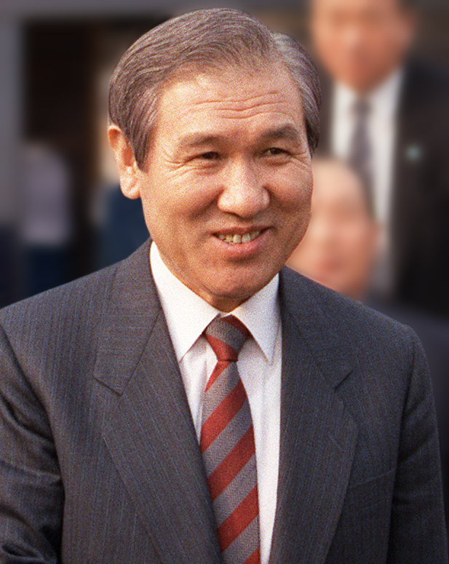
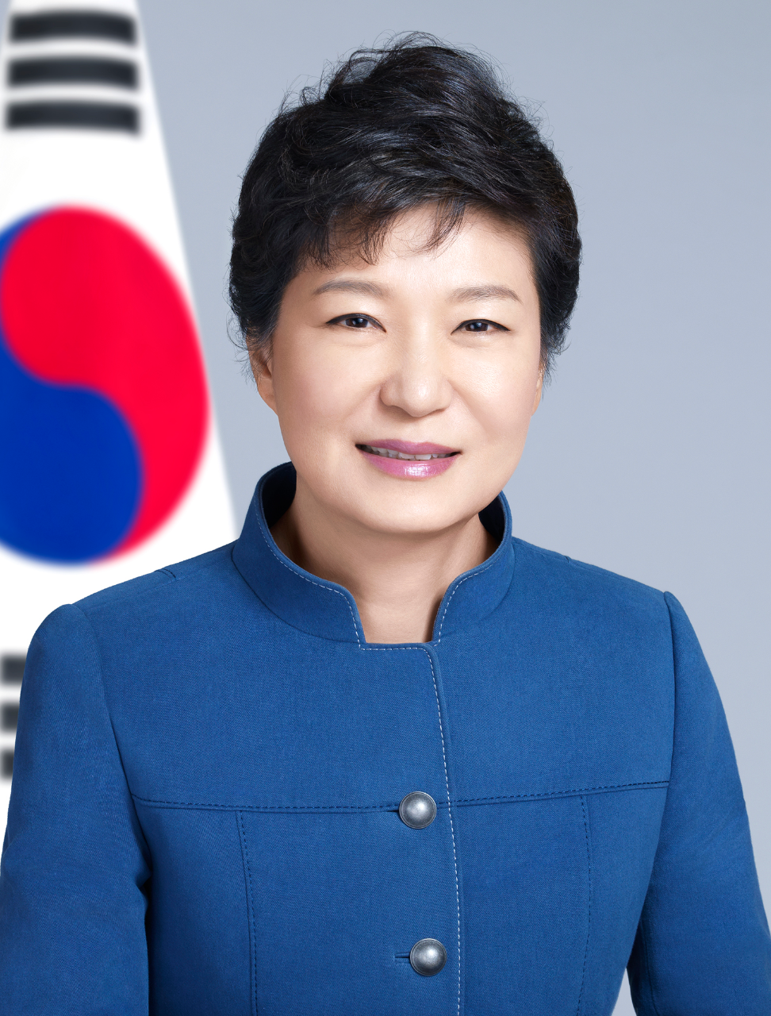
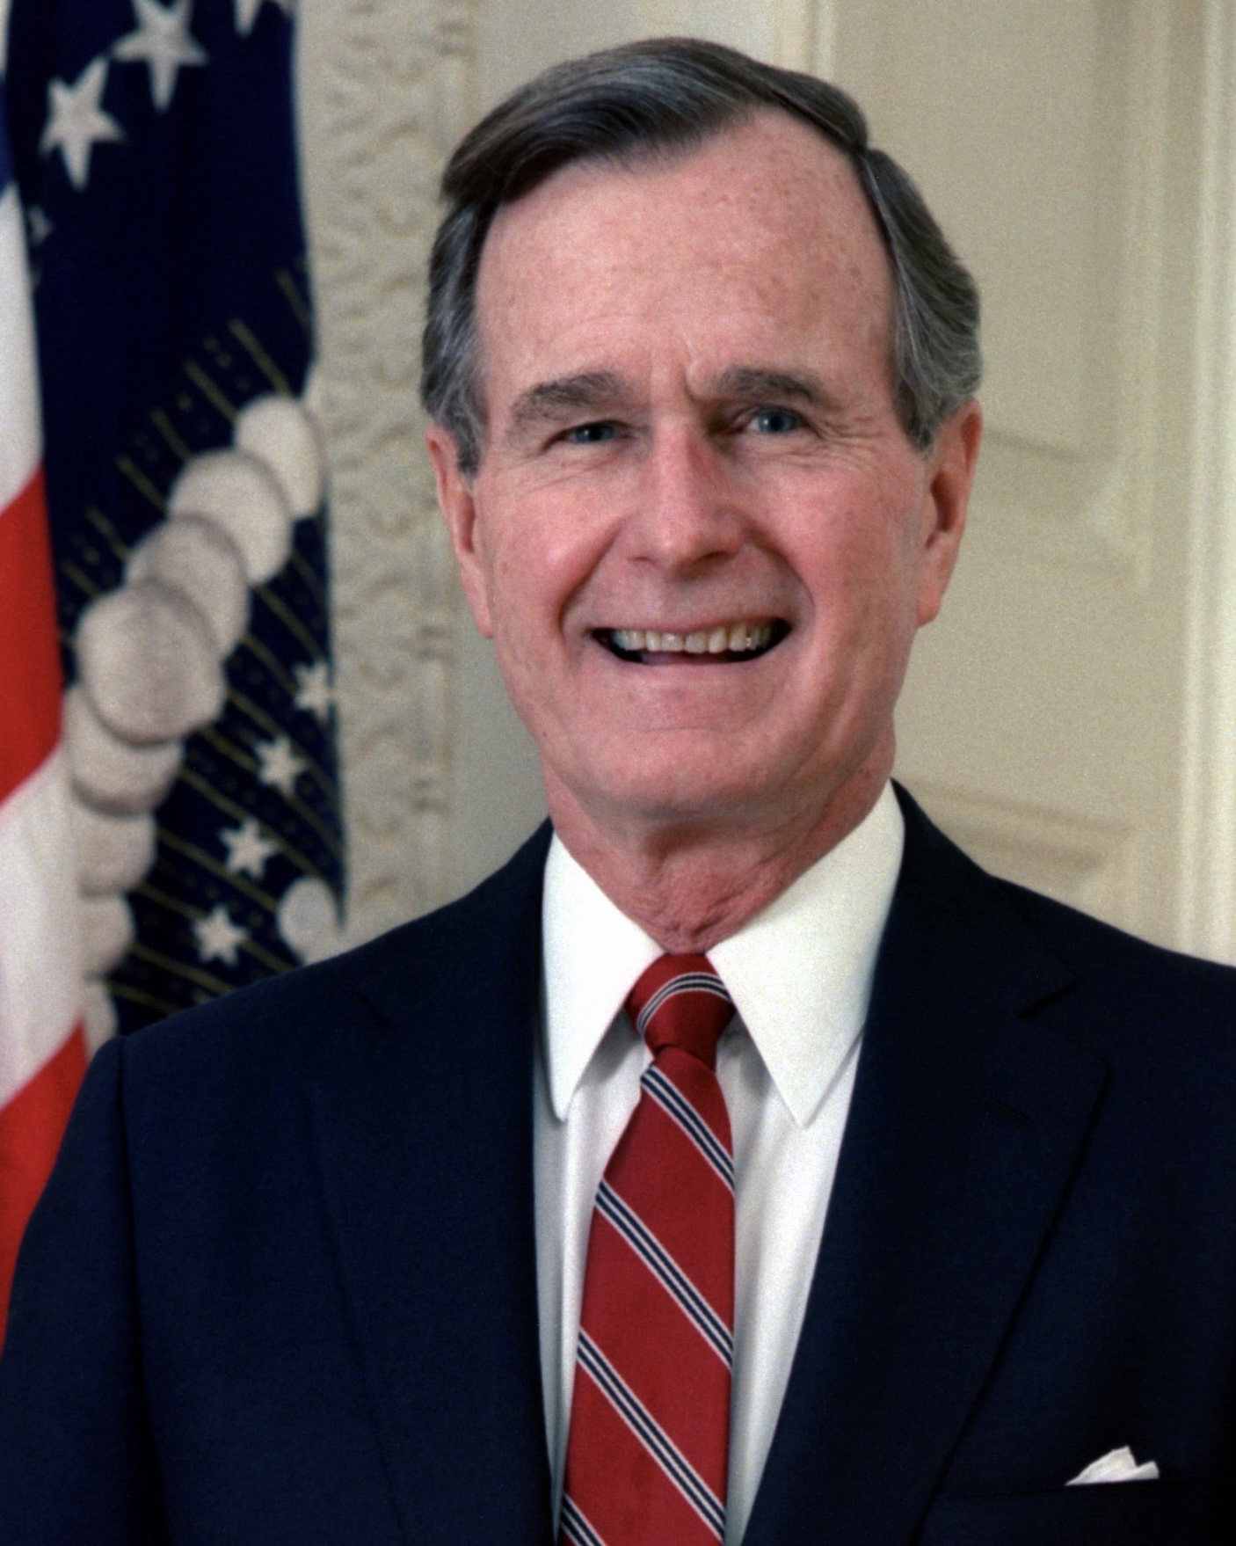
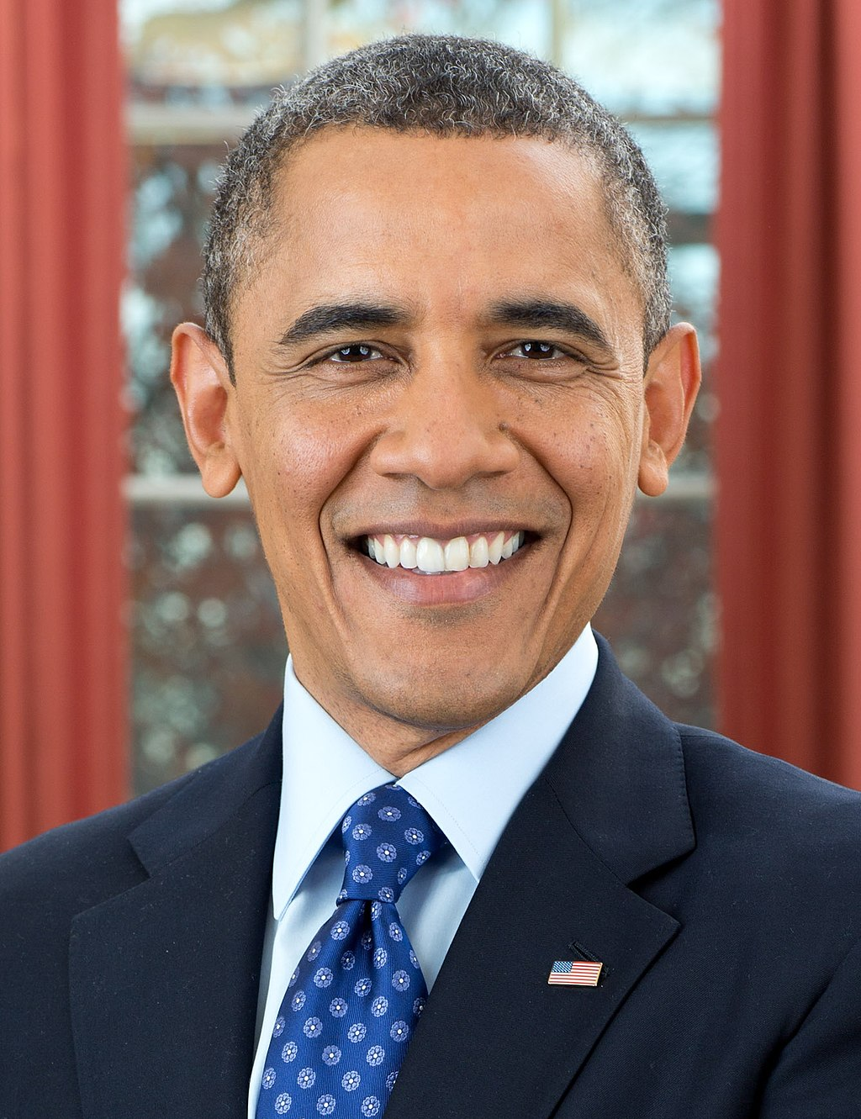
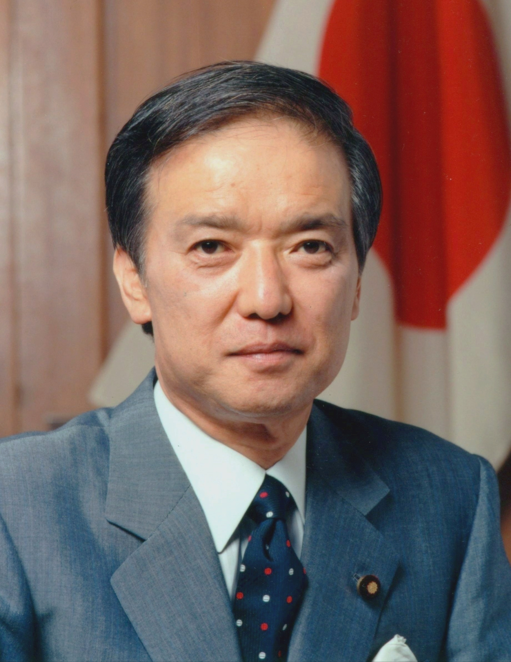
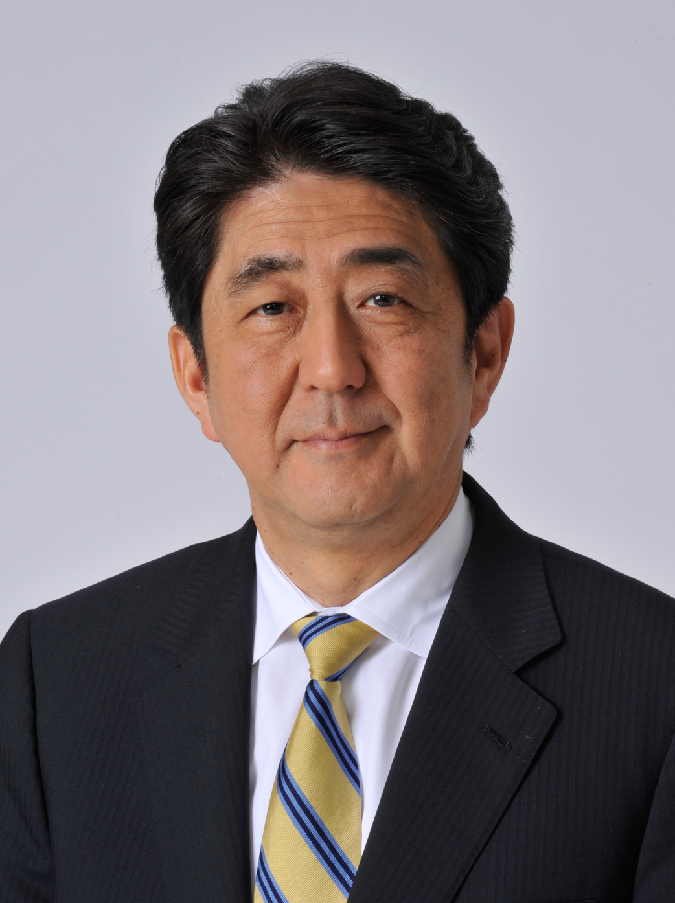
Together with us, North Korea, as a responsible member of the international community and as a nation, must agree on specific measures to resolve military confrontation and build peace on the Korean Peninsula and put them into practice.
South Korea
I hope that North Korea will abide by the norms of the international community and make the right choice so that the trust-building process on the Korean Peninsula can progress.
Tae-woo Roh
Geun-hye Park
We will continue to adhere to our policy of dialogue and pressure on North Korea, and we will do our utmost to ensure the safety and immediate return of all abductees, clarify the truth about the abductions, and hand over the perpetrators of the abductions.
I did explain our, shall I say, diplomatic schedule ahead of us with the Soviet Government and the North Korean Government which we would like to promote for the purpose of attaining peace, stability, and prosperity in the Asia-Pacific region.
Positive
Stance repetition on
‘North Korea’ issue
In 1991 and 2014
Positive
Positive
U. S. A.
The establishment of diplomatic relations between South Korea and the Soviet Union and the movement of exchanges between South and North Korea are highly evaluated as efforts toward peace and stability on the Korean Peninsula. I hope that it will resume soon and that we will see substantial progress.
Japan
The regime in North Korea must know they will only achieve security and prosperity by meeting their international obligations.
George H.W. Bush
Barack Obama
Kaifu Toshiki
Abe Shinzo

Slide 3
Embedding Vector
Document ID
Doc2Vec
Model
Text
Document ID
Cosine
Similarity
Document ID
Document ID
Text

Slide 4
Address Embedding
Interaction
Similarity > 0.7
Time
T1
T2
T3

Slide 5
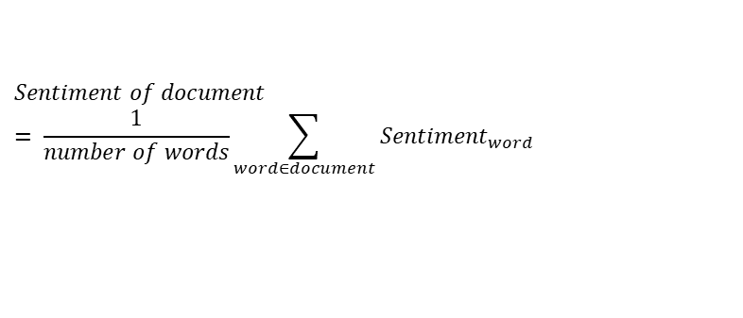
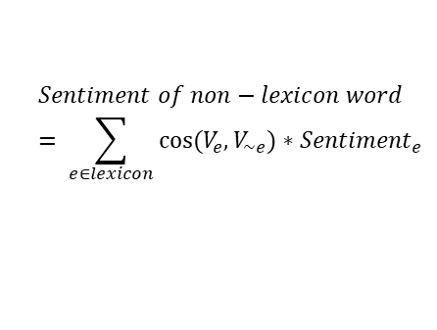
Words
Words
Word
embedding
Documents
=
Document
embedding
Latent Vector Size
$$Sentiment of non−lexicon word= \sum_{e∈lexicon}{\cos{(V_{e},V_{\sim e})}∗{Sentiment}_{e}}$$
$$Sentiment of document= \frac{1}{number of words}\sum_{word∈document}{{Sentiment}_{word}}$$

Slide 6
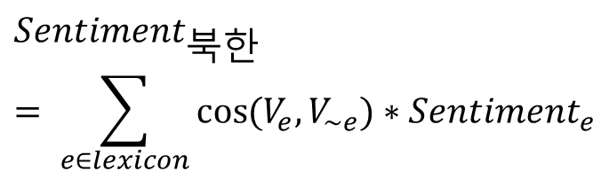
북한
도발
미사일
핵
 | 북한 | 도발 | 미사일 | 핵 | …
D1 | 2 | 4 | 3 | 3 | …
SVD
…
도발
북한
미사일
$${Sentiment}_{북한}= \sum_{e∈lexicon}{\cos{(V_{e},V_{\sim e})}∗{Sentiment}_{e}}$$
Cosine Similarity
핵

